Slide 1

Mambo No. 5: A Little Bit of Kotlin in My Life, A Little Bit of Scala 3 in My Mind
Anthony Accioly

Slide 2




Agenda
Java & Kotlin & Scala 3
Main: Let’s start from the start
Enums
Extension methods
Kotlin & Scala 3 (Encore)
https://github.com/aaccioly-demos/mambo-no5

Slide 3
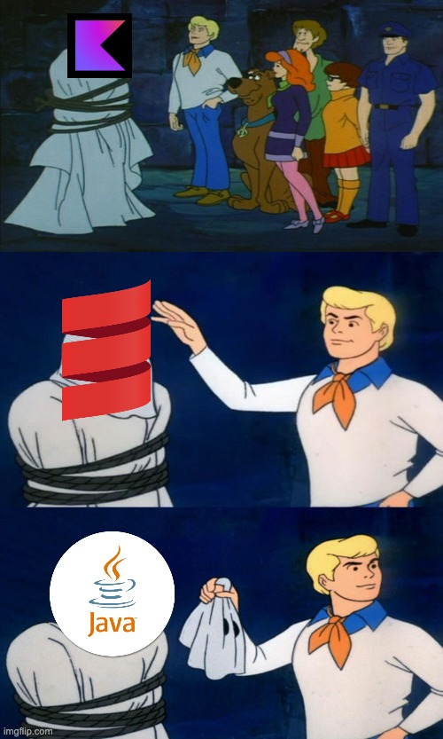
Java & Kotlin & Scala 3
Something about me
Something about you
Something about this talk
Something about the languages

Slide 4

May 23rd, 1995

Slide 5




timeline
1995-1996
2001-2004
2016
2021
2023
3

Slide 6
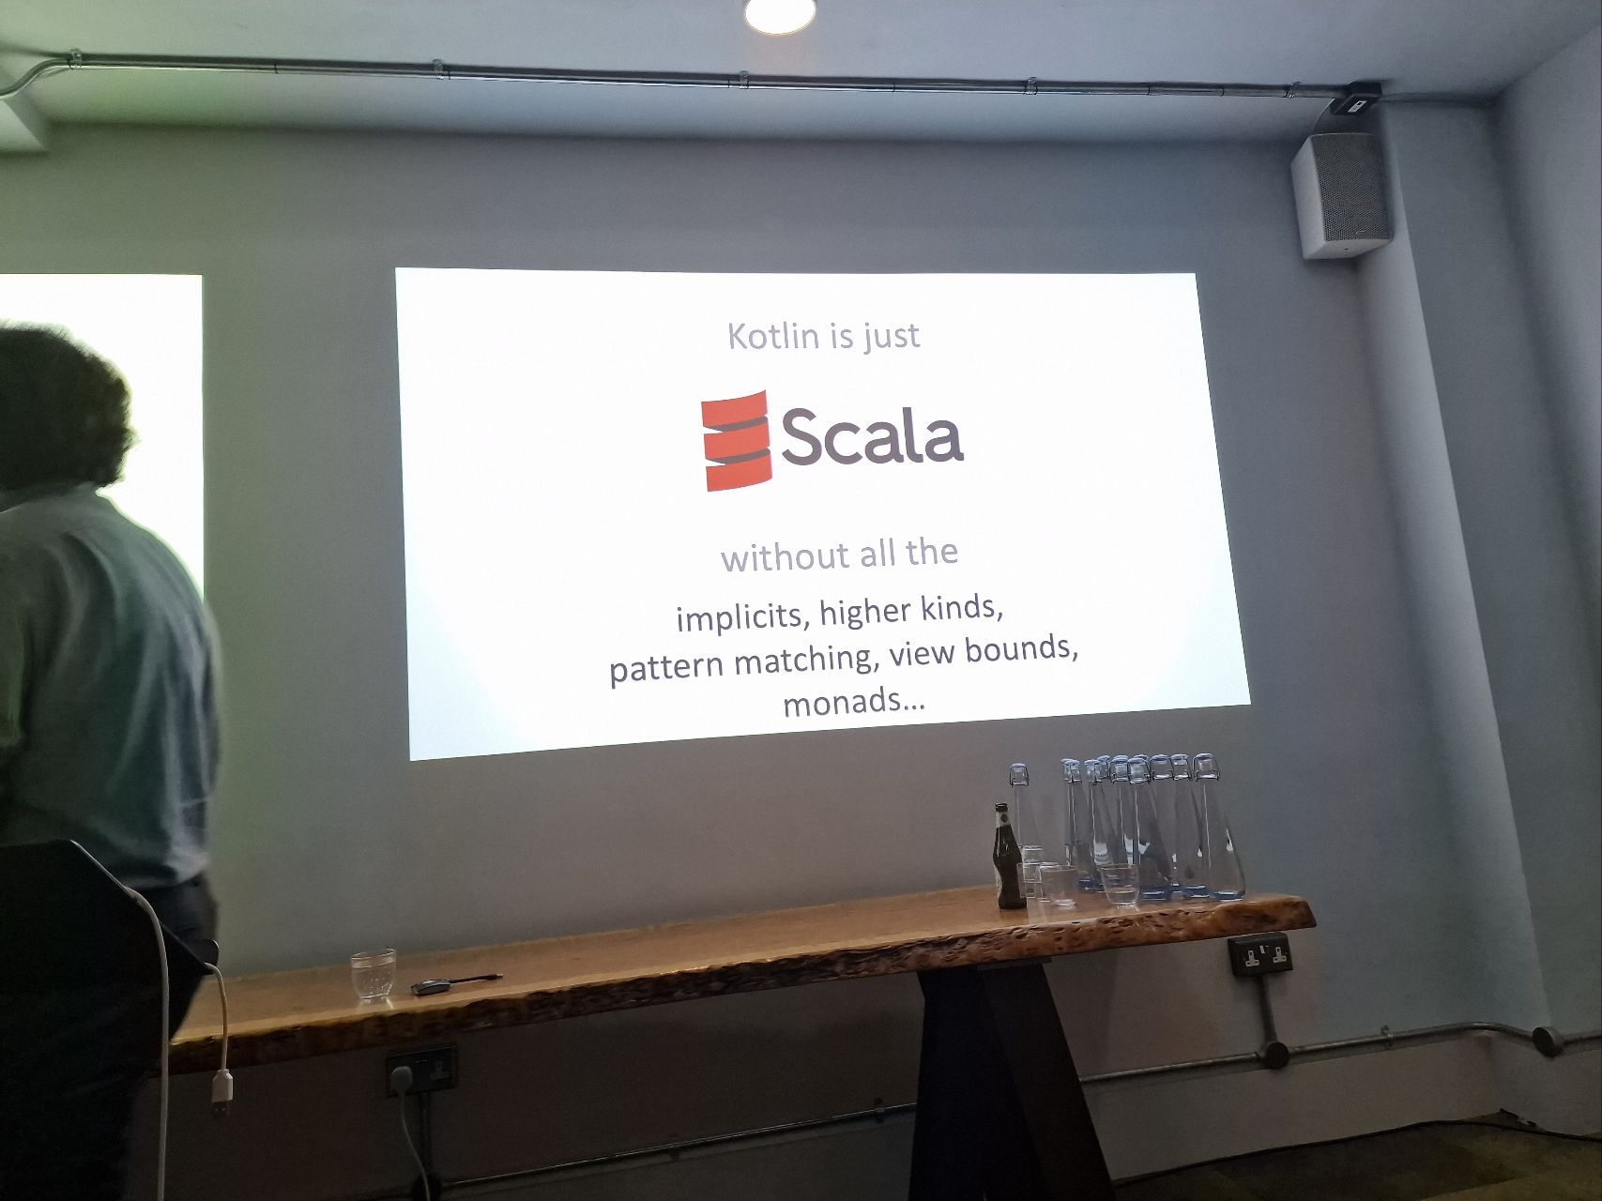
KOTLIN is…
Fist and foremost a pragmatic language
Great tooling
Gaining popularity in the industry
Not restricted to Android
Source Talks: On Kotlin #5 with Andrey Breslav – Shoulders of giants

Slide 7
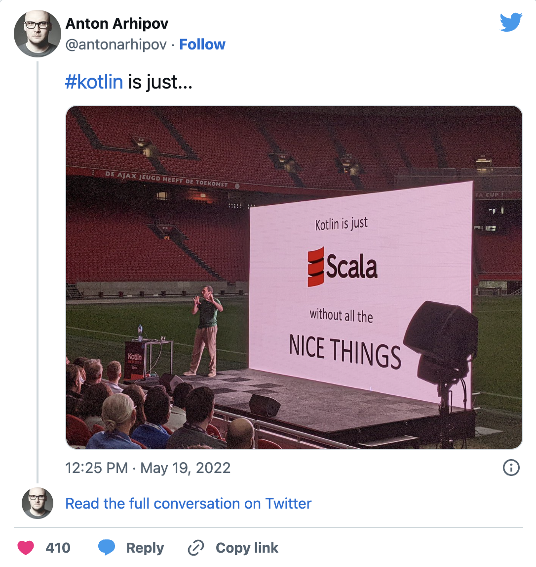
Scala 3 is…
Powerful
Faster than Scala 2
Simpler than Scala 2
Still finding its place in the industry
https://twitter.com/antonarhipov/status/1527249040244723713

Slide 8


Can a language be too powerful for its own good?
Cleaning up some of Scala's features

Slide 9

SCaLa 2 ASCII ART
val l = List(1, 2, 3, 4, 5, 6, 7, 8, 9, 10)
(0 /: l)(_ + _)
// (╯°□°）╯︵ ┻━┻
A cheap shot at a deprecated feature
But Scala 3 is cleaning up a lot of things.
Syntax, Symbols, arity-0 magic, implicits, macros, existential types and much more.
Common theme: JVM languages are converging

Slide 10

DEMOS: The way to get started is to quit talking and begin doing.
Walt Disney

Slide 11
Hello, World! across languages
Java
Kotlin
Scala
Lots of boilerplate
What’s a class? What’s public? What’s static?
Getting better: JShell, JBang, JEP 445.
Clean top level function
Proper tools for beginners REPL, Scripting & Worksheets
Simple but getting more powerful. E.g., Script dependencies.
Scala 2 still needed some boilerplate.
Proper tooling OOB, but can be a little messy
Ammonite, Scala CLI.
Scala 3: Clean,powerful and typesafe

Slide 12
Enums
Java
Kotlin
Scala
Enums are surprisingly powerful and clean
Now that Record classes are a thing, Enums could use some simplification
Basically better Java Enums
Top level constants, companion objects, etc
Unnecessary class keyword
Scala 2 Enumerations were messy, no way around it.
Roll your own solution with ADTs, or use liblike Enumeratum.
Scala 3 closed the gap
Unnecessary case keyword

Slide 13
Extension Methods
Kotlin
Scala
Clean syntax
One method at a time
Interesting complementary ideas such as Function Types with Receivers and Type-Safe Builders.
Scala 2: Implicit conversions / Pimp My Library Pattern
Scala 3: new extension keyword
Part of Implicits clean-up (given, using)
Powerful tools to create DSLs

Slide 14


KOTLIN & SCALA 3
Some of the best features of Java, Kotlin & Scala 3 are converging
By design Scala is the more powerful language
Kotlin is a cool language with some nice features of its own OOB (E.g., Null safety, Continuations / Coroutines)
It’s relatively easy to transition from Scala to Kotlin
Choice is a good thing

Slide 15







Questions?
https://www.linkedin.com/in/aaccioly
@anthony@mastodon.accioly.dev
https://stackoverflow.com/users/664577
https://accioly.dev
a.accioly at protonmail.com
Mambo No. 5: A Little Bit of Kotlin in My Life, A Little Bit of Scala 3 in My Mind © 2023 by Anthony Accioly is licensed under CC BY-SA 4.0
https://github.com/aaccioly-demos/mambo-no5

